Slide 1
VisiCompanion: Comparative Study of YOLOv8 and YOLOv9 for Grocery Detection
KIET Group of Institutions, Ghaziabad
Mentor:- Payal Chhabra
Members:- Vibhore Jain, Tanmay Arora, Neeraj Gandhi, Swapnil Bhatnagar

Slide 2



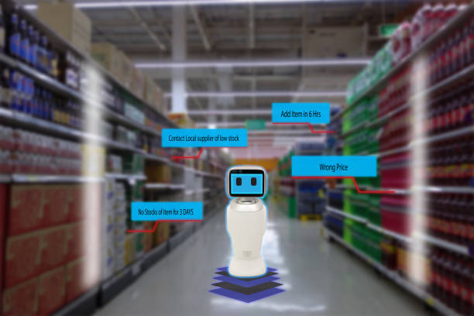

Introduction
Overview
Objective
Importance
Assists visually impaired individuals in identifying groceries.
Uses real-time object detection and audio feedback.
Image Capture:
Camera captures grocery images.
Object Detection:
YOLOv8 & YOLOv9 analyze the objects.
Audio Feedback:
Identified items are conveyed via voice output.
Detects objects using YOLO models.
Provides real-time audio feedback.
Supports independent shopping.
Addresses accessibility challenges for millions.

Slide 3

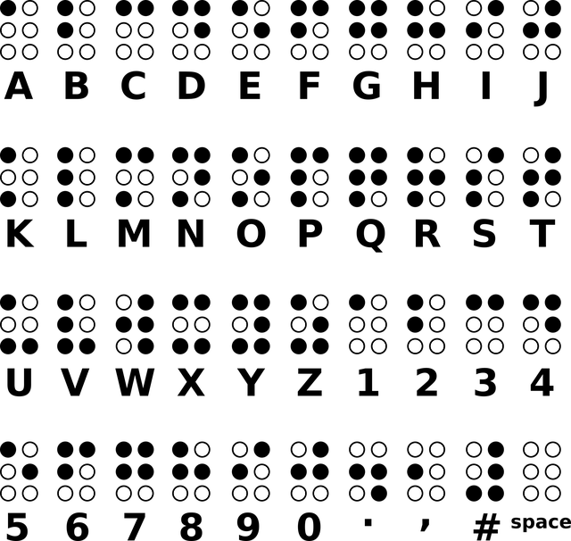
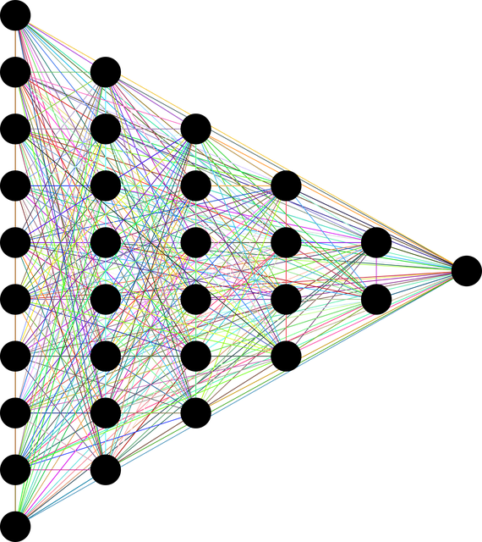

Background
Challenges & Existing Solutions
Research Gap & Solution
Challenges:
Supermarkets lack Braille labels.
Existing Solutions:
Expensive Smart glasses.
Visually impaired individuals rely on others for product identification.
Barcode scanners with accessibility limitations
Non-optimized object detection models.
Identifying the Gap:
Need for real-time, cost-effective, high-accuracy assistive technology.
Proposed System:
Uses AI-powered object detection
Provides instant audio feedback for identified products.
Expected Outcome:
Increased independence for visually impaired shoppers.

Slide 4
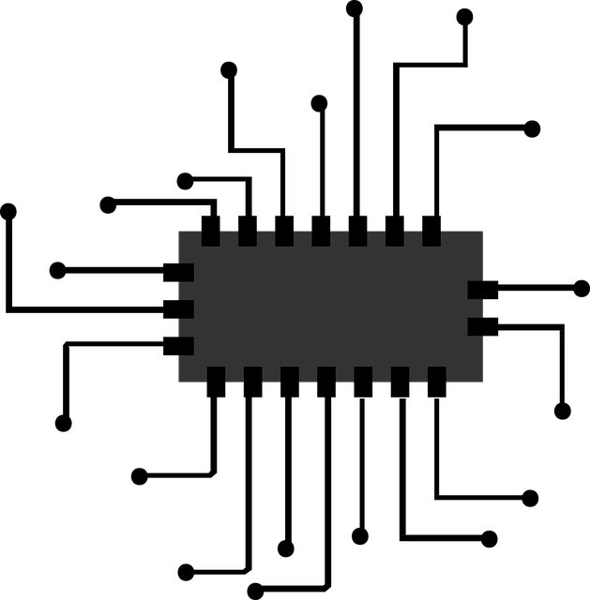

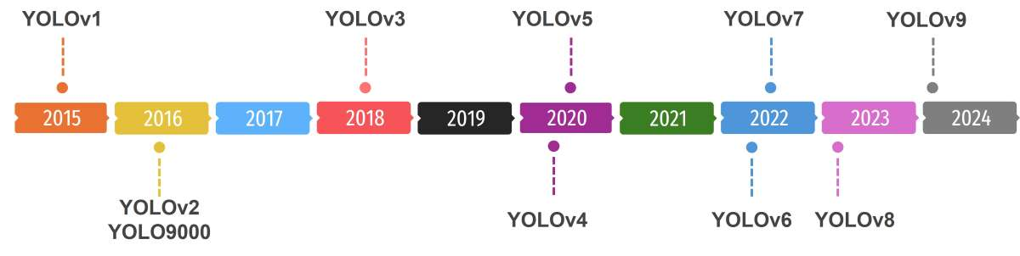

Related Work
Research on Object Detection for Assistive Tech
Improved small object detection over time.
Overcame slow processing & low accuracy.
With YOLO you can:
ASSISTIVE TECH
Slow Speed
High Cost
Low Accuracy
Previous models aimed at assisting visually impaired users.
Lacked real-time efficiency, causing delays.
YOLO-Based Detection

Slide 5
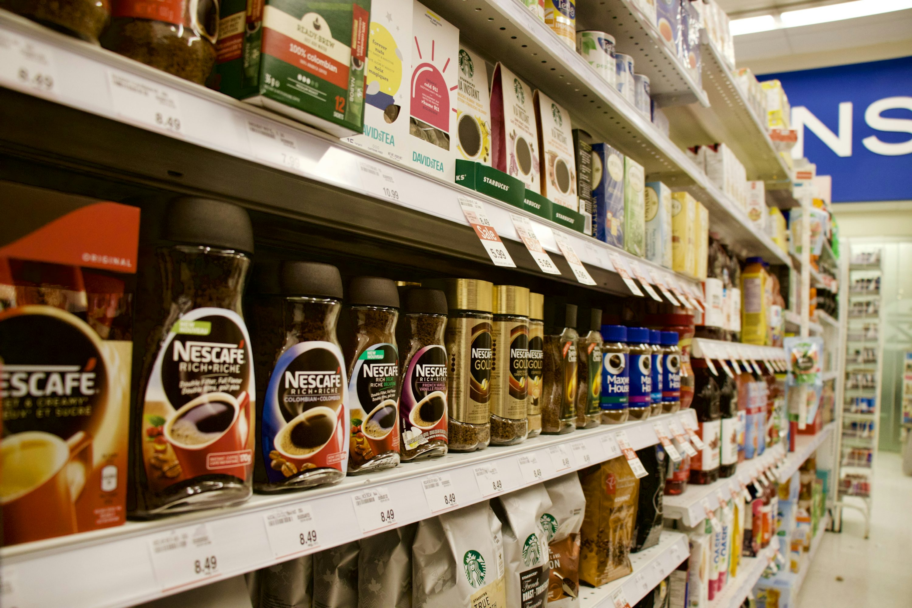
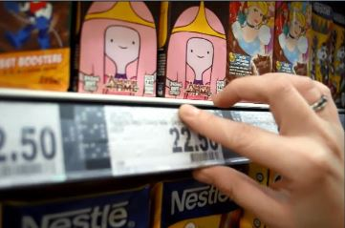
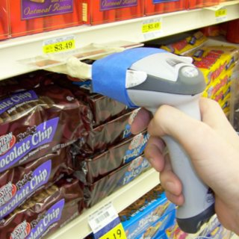
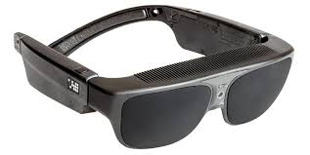


Problem Formulation – The Need for Grocery Detection for the Visually Impaired
Real-World Problems
Without Braille
With Braille
Lack of Product Identification
Dependence of External Assistance
Limitations of Existing Assistive Tech
Difficulty in Detecting Small & Overlapping Objects
Scanners:-
Price: 3k-5k
Assistive Glasses:-
Price: 8k-15k
Objectives
Compare the Performance of Yolov8 and Yolov9
Analyze the Trade-off Between Speed and Accuracy
Assess Model Suitability for Assistive Tech
Provide Quantitative Insights Through Performance Metrics
YOLOv8
Faster Inference
Slightly Lower Accuracy
YOLOv9
Higher Accuracy
Resource Intensive

Slide 6
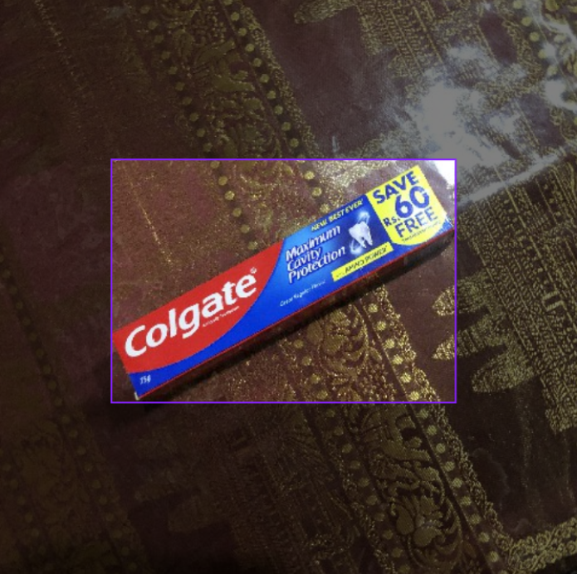
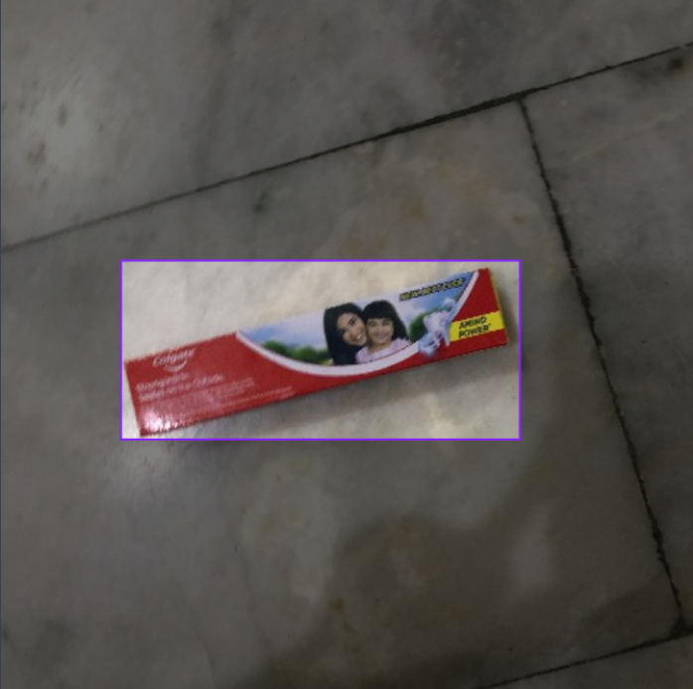
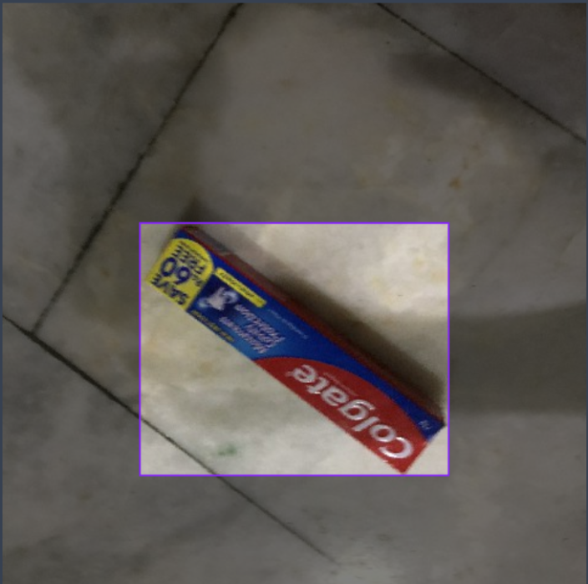
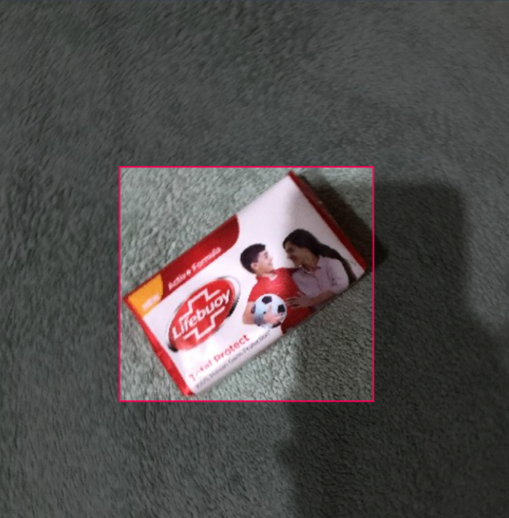
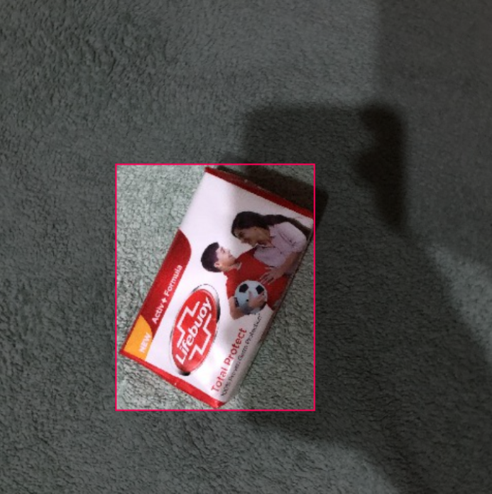
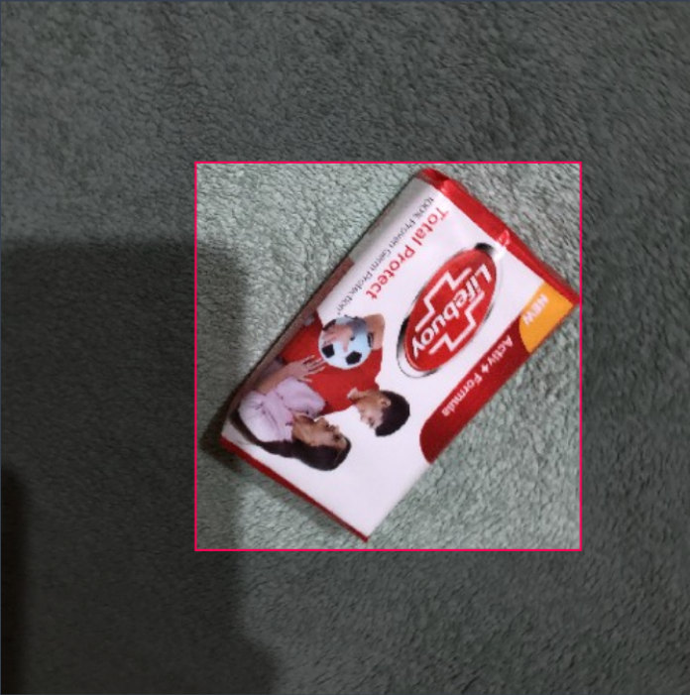
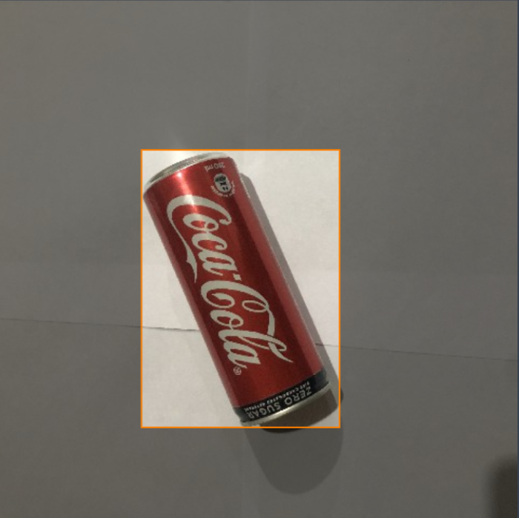
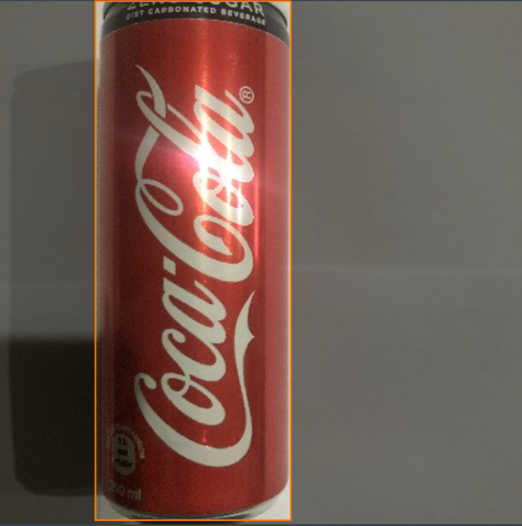
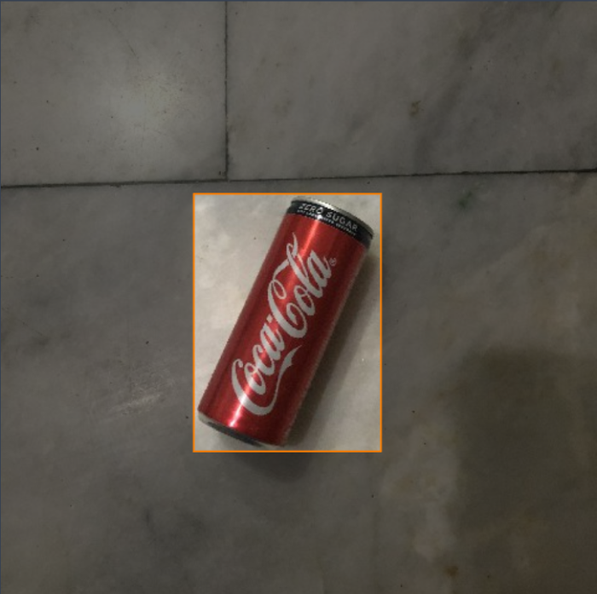
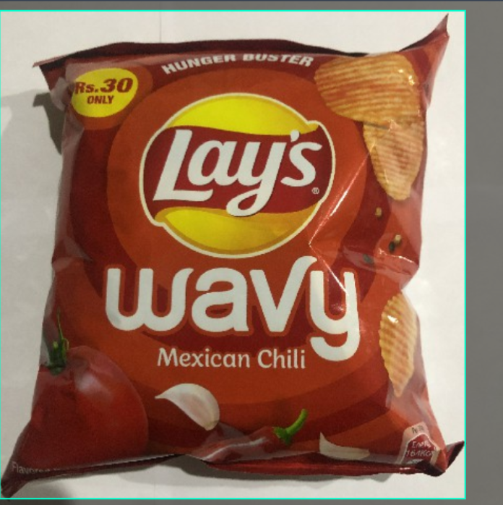
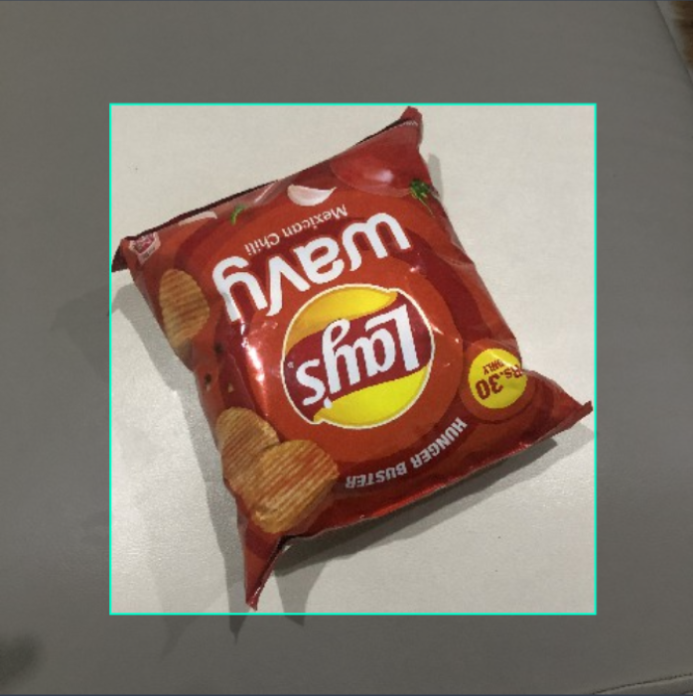
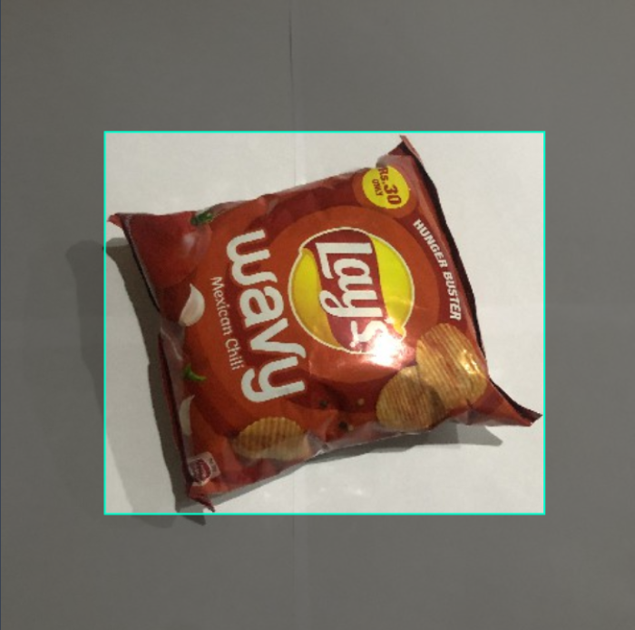
Dataset Collection & Preprocessing
Preprocessing Methodology
Dataset Samples
Data Collection
Data Preprocessing
Data Augumentation
Dataset Splitting
Source: 2,100 images from Roboflow
Categories: 7 grocery product classes
Diversity: Varied lighting, angles, and
Backgrounds
Resizing: Standardized to 640×640 pixels
Noise Reduction: Removing unwanted artifacts
Contrast Adjustment: Enhancing visibility
Flipping & Rotation: Different viewing angles
Brightness & : Simulating real-world conditions
Contrast Tweaks
Training: 70% for learning
Validation: 20% for tuning
Testing: 10% for evaluation

Slide 7
Model Selection & Training
Model Comparison
Training Workflow
YOLOv8
Like a sprinter—fast but may miss details
YOLOv9
Like a marathon runner—slower but more precise
Feature Extraction
Training
Pre-Processing
Evaluation
Hyperparameters Used
Learning Rate
0.01
Batch size
YOLOv8 : 32
YOLOv9 : 16
Epochs
10
Controls model weight updates
Smaller Batches complex models
Number of times dataset is processed

Slide 8
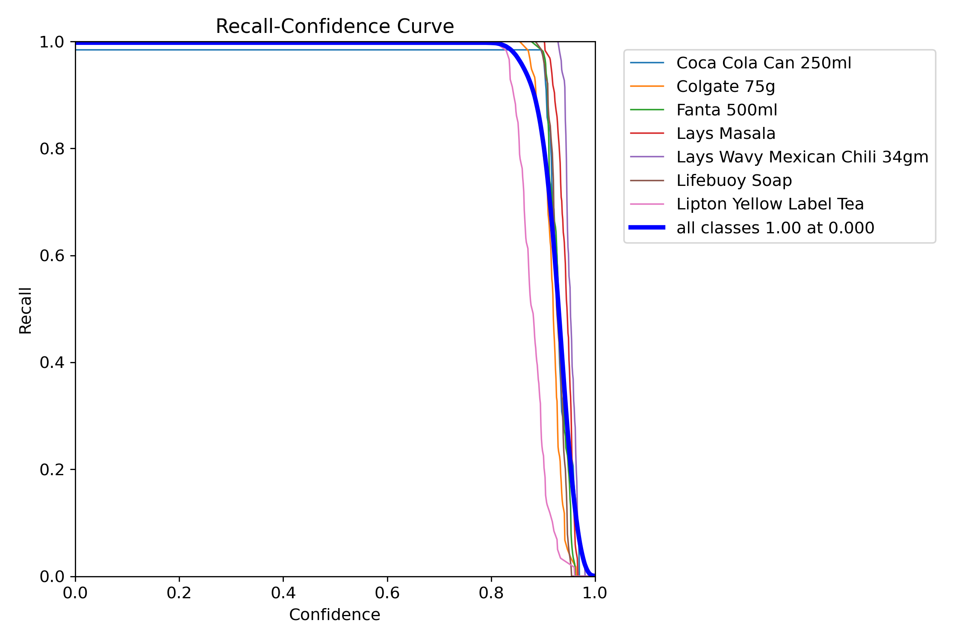
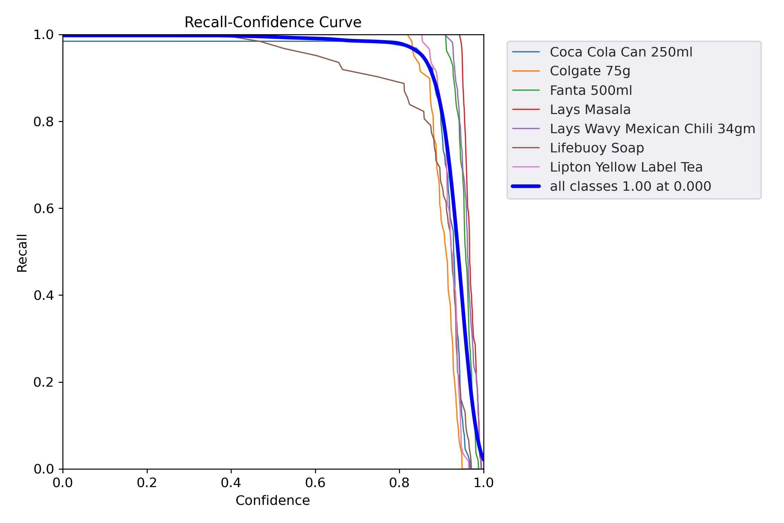
Evaluation Metrics
Comparison Graphs
mAP (Mean Average Precision)
Measures how accurately the model detects and classifies objects across multiple categories.
Precision
Tells us how many of the detected objects are actually correct.
Recall
Measures how many actual objects the model successfully detects.
FPS (Frames Per Second)
Determines how fast the model processes frames in real time.
YOLOv8
YOLOv9

Slide 9
Model Trade-offs & Best Choice
YOLOv8
Best for real-time, mobile-friendly applications with lower computational power.
YOLOv9
Ideal for cloud-based, high-accuracy use cases where precision is critical.
Efficient for edge devices and embedded systems due to its lightweight architecture.
Suitable for applications like robotics, AR, and autonomous drones requiring quick decisions.
Requires GPUs or high-performance servers for optimal performance.
Preferred for industries like medical imaging and security surveillance where precision matters more than speed.
Speed vs. Accuracy
YOLOv8 excels in inference speed, while YOLOv9 achieves 95% mAP for superior detection.
Computational Cost
YOLOv9 demands higher resources, making it less suitable for edge devices.
Optimization Potential
Techniques like quantization & pruning can bridge the gap.
Deployment Suitability

Slide 10
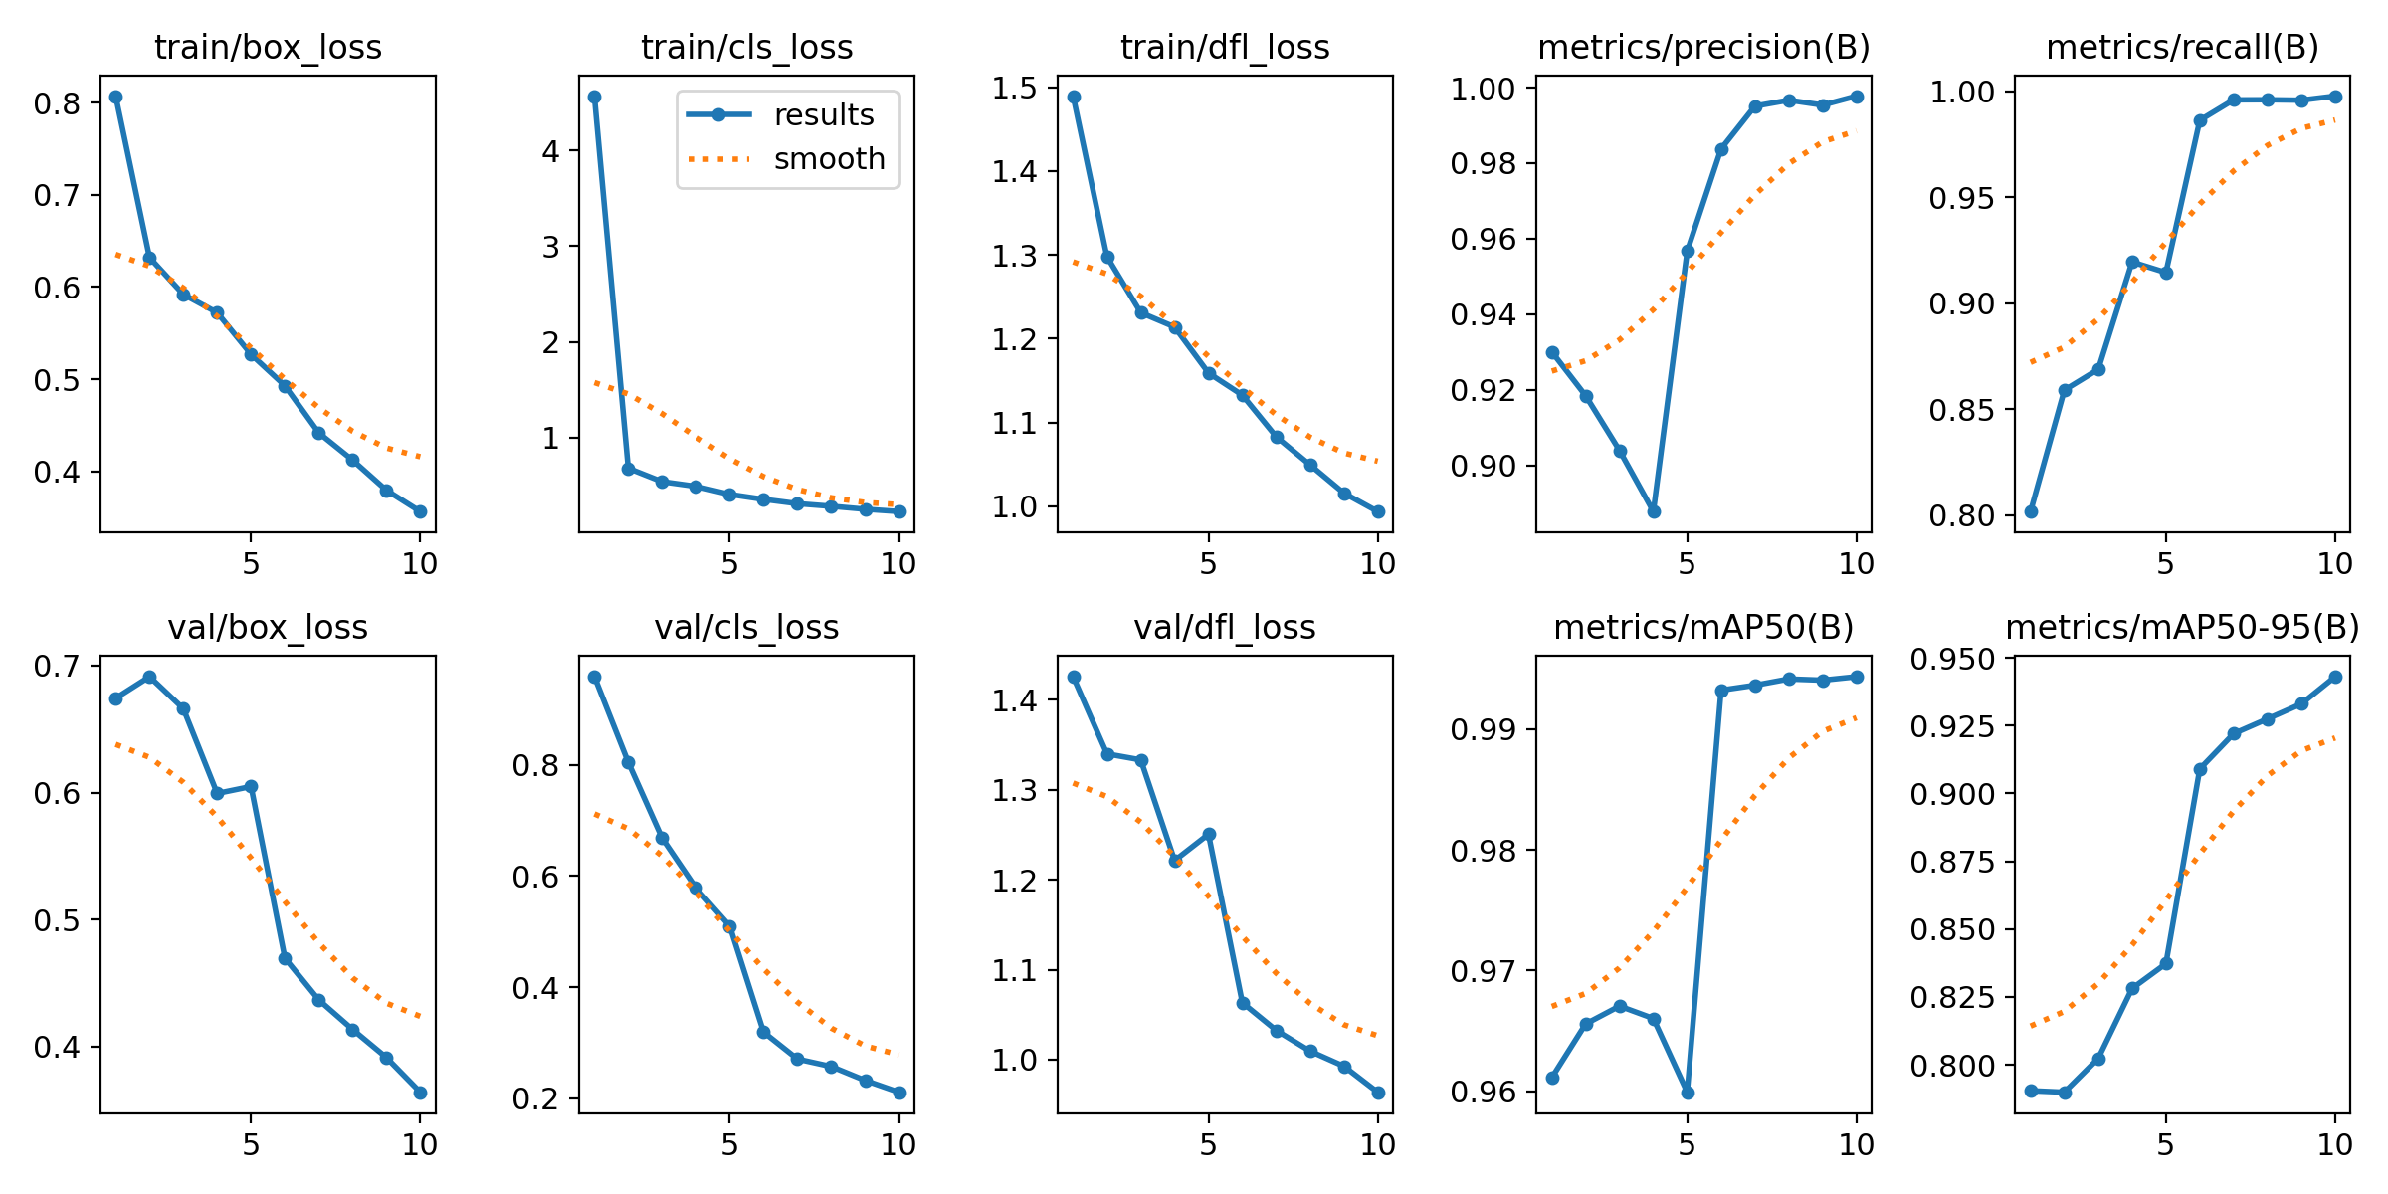
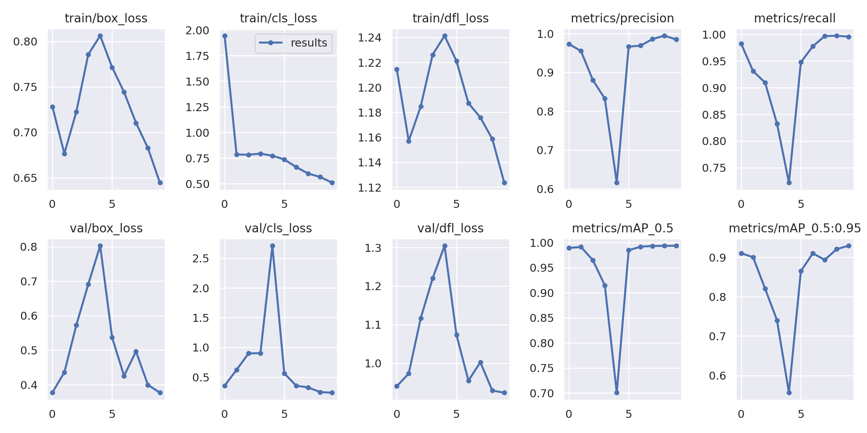
Performance Comparison
Precision
YOLOv9 reaches 96.8%, ideal for high-confidence detections
Speed
YOLOv8 is faster, running at 50 FPS
35 FPS for YOLOv9 — better for real-time applications
Small Object Detection
YOLOv9 outperforms in handling smaller objects, critical for dense environments.
YOLOv8
YOLOv9
Metrics | YOLOv8 | YOLOv9
mAP | 93.5% | 95%
Precision | Moderate | 96.8%
FPS | 50 FPS | 35 FPS
IOU | 0.8 | 0.85
Small object detection | Moderate | Better

Slide 11
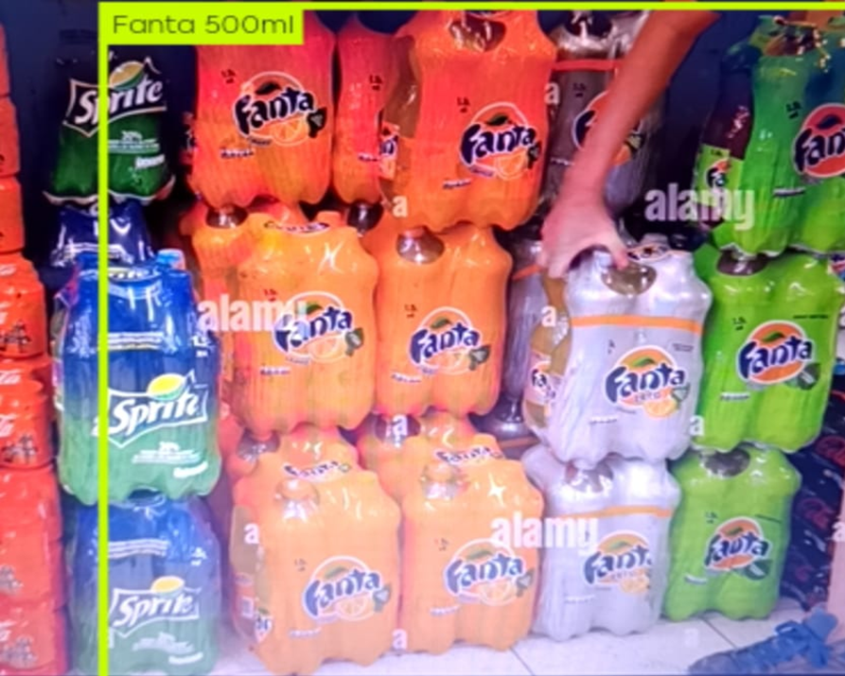
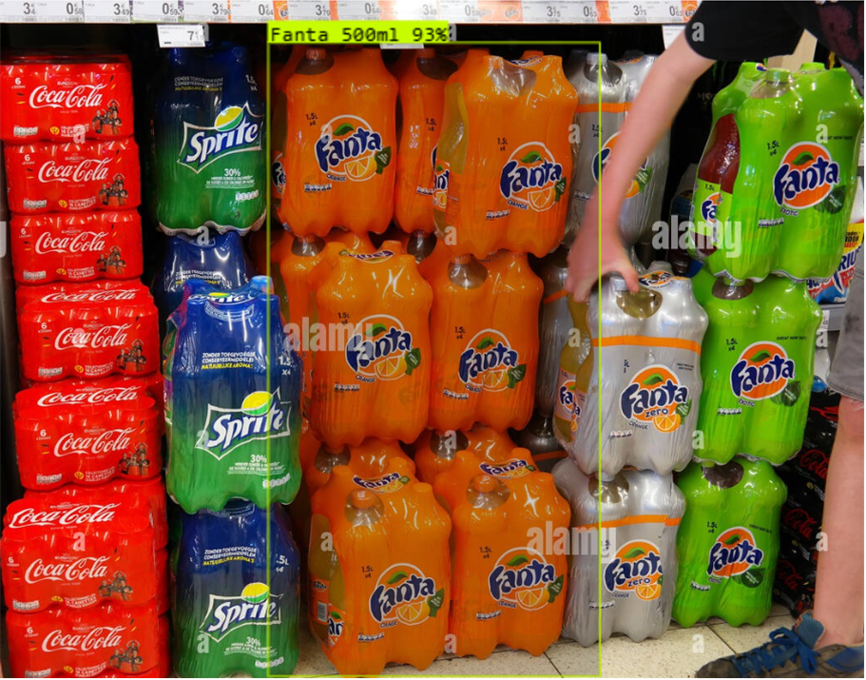
Bounding box visualization
Yolov8
Yolov9
Larger, single bounding box covering grouped items
Detected Fanta 500ml with 93% confidence
Simplifies detection by enclosing clusters of bottles
Precise and multiple, detecting individual bottles
YOLOv8:
Precise but smaller bounding boxes, better for individual object detection.
Broader bounding boxes, effective for detecting grouped items, potentially reducing false positives
YOLOv9:

Slide 12
Conclusions and Key Takeaways from Our Research
From our comprehensive study on grocery detection using YOLOv8 and YOLOv9,
we derive the following insights:
YOLOv9
YOLOv8
YOLOv8, with its lower computational cost and faster inference, is better suited for real-time mobile deployment.
Validation & Feasibility
Our findings validate the feasibility of YOLO-based models for real-world grocery detection, ensuring a balance between accuracy and efficiency.
YOLOv9 achieves the highest accuracy (mAP 95%), making it ideal for high-precision applications.
The project successfully trained and deployed both models on a diverse grocery dataset, integrating real-time assistive technology.
Model Training & Deployment

Slide 13
Future Work & Potential Improvements
Dataset Expansion
Edge Deployment
Optimize for smartphones & embedded systems to improve accessibility.
User Testing
Gather real-world feedback from visually impaired users to refine usability.
Add more grocery items, diverse lighting, and backgrounds for better model generalization.
Incorporate OCR & barcode scanning for richer product details.
Multimodal Integration
Technical Improvements
Faster Processing
Cloud Optimization
Offload heavy computations for real-time performance.
Use pruning & quantization to reduce computational load.
Optimize models to balance precision with real-time efficiency.
Accuracy vs. Speed

Slide 14
Acknowledgement
Team VisiCompanion sincerely express our gratitude to:
Our Faculty for their valuable guidance and encouragement throughout our research.
Our Institution for providing us with the necessary resources and a platform to explore and innovate.
Our Research Mentors for their continuous support, insightful feedback, and expertise, which helped shape our work.

Slide 15
Thank You

